Slide 1
Machine Learning In Physics
Presenter: James Shaddix

Slide 2
What Is Machine Learning?
Subfield of Artificial Intelligence
Focuses on statistical model development
You enhance you model through “training”.
Supervised learning makes predictions based on a data sets history of responses.

Slide 3
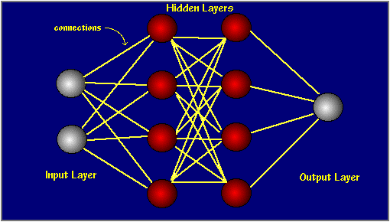
Neural Network Structure:
Algorithm for producing a Statistical model
Black Box Behavior: Produces a Line of Best Fit

Slide 4
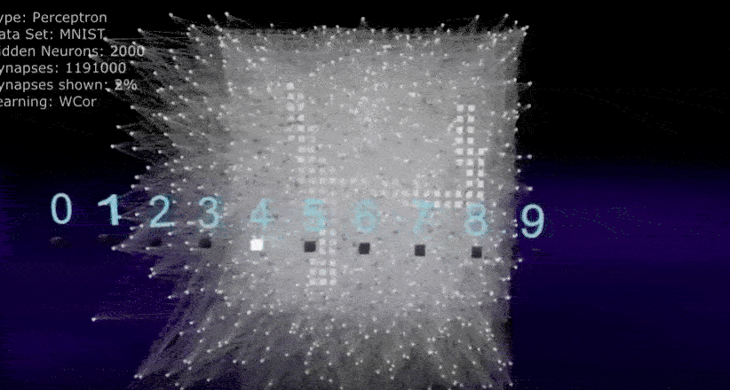
Image Recognition of Hand-Written Digits

Slide 5
MicroBooNE Experiment
Used Liquid Argon time projection chambers to study Neutrino Interactions.
Used convolutional neural networks to classify particles in images.

Slide 6
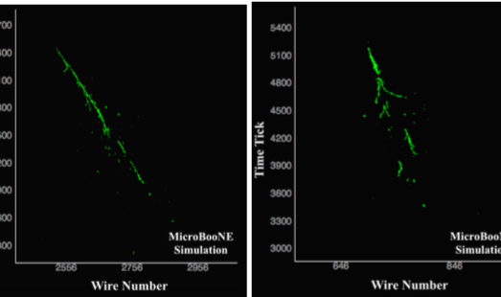
Electron And Proton Signature

Slide 7
Refferences
R Acciarri et al 2017 JINST 12 PO3011

